Slide 1
Course Unit: Structured Programming
BCS 1202
NAME: Andrew Tugume
Email: atandretug8@gmail.com
Tel Contact: 078/0703-726787
Assistant Lecturer
SOIC
1

Slide 2
Module One: Introduction to Programming Languages
What will be covered.
Introduction to Computer Programming and programming Language concepts,
Generations of Programming Language
Types of Programming Languages
Problem solving techniques in programming
Understand the basic procedures in a program as input, processing and output

Slide 3
Concepts of Programming.
Definition: A program is a series of step-by-step instructions that provides a solution to a particular problem and directs the computer on what to do exactly. Though a program is a set of instructions, but the statements must be submitted to a computer as a unit to direct the computer behavior.
A computer program is a collection of instructions that performs a specific task when executed by a computer. A computer requires programs to function, and typically executes the program's instructions in a central processing unit.
A computer program is a step by step set of instructions that a computer has to work through in a logical sequence in order to carry out a particular task. The computer executes these instructions (obeys the instructions) when told to do so by the user

Slide 4
What is programming?
The process of developing and implementing various sets of instructions to enable a computer to do a certain task. These instructions are considered as computer programs and help the computer to operate smoothly.
Programming is the implementation of logic to facilitate specified computing operations and functionality. It occurs in one or more languages, which differ by application, domain and programming model
Computer Programming is defined as the process of creating computer software using a programming Language. Computer programs are written by Human individuals(Programmers)

Slide 5
Structured Programming
Structured programming is a programming paradigm aimed at improving the clarity, quality, and development time of a computer program by making extensive use of the structured control flow, constructs of selection (if/then/else) and repetition (while and for-loops), block structures, and subroutines
Structured Programming Approach, as the word suggests, can be defined as a programming approach in which the program is made as a single structure. It means that the code will execute the instruction by instruction one after the other. It doesn’t support the possibility of jumping from one instruction to some other with the help of any statement like GOTO, etc. Therefore, the instructions in this approach will be executed in a serial and structured manner. The languages that support Structured programming approach are:
C,C++,Java,C#,..etc

Slide 6
Computer Programming Languages:
A programming language is an artificial or formal language that can be used to control the behavior of a machine or language designed to communicate instructions to a machine particularly a computer.
A programming language can be defined as – “The language used for expressing a set of instructions that can be executed by the computer”.
Programming languages can be used to create programs to control the behavior of a machine or to express algorithms
Programming languages, like human languages, are defined through the use of syntactic and semantic rules, to determine structure and meaning respectively.

Slide 7
Why programming languages?
Programming languages are used to facilitate communication about the task of organizing and manipulating information, and to express algorithms precisely.
For 50 years, computer programmers have been writing code. New technologies continue to emerge, develop, and mature at a rapid pace. Now there are more than 2,500 documented programming languages!

Slide 8
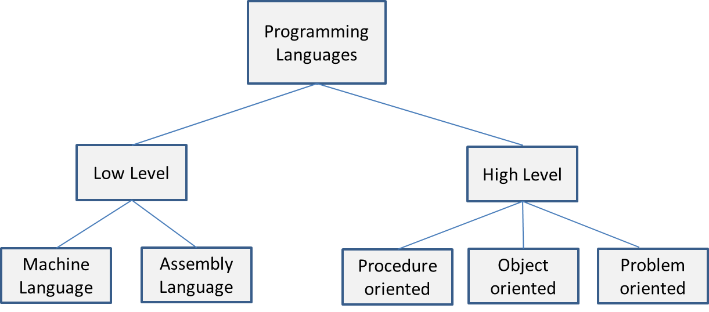
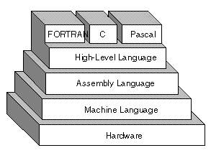
Categories of Programming Languages
Programming languages are divided into two major categories:
A low level language is machine dependent; that is, it is written to run on one particular computer.
A high level language is machine independent, which means the high level language code can run on many different types of computer.

Slide 9
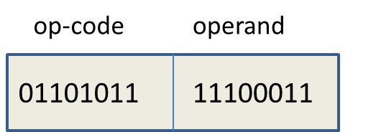
Machine Language.
Machine language is a computer programming language consisting of binary or hexadecimal instructions which a computer can respond to directly The machine language was used to write programs using the machine code of 1s and 0s, which is directly understood by the computer. Computer works on binary electronic pulses – 0s and 1s. However, the CPU is a passive device. It cannot work on its own, in the sense that every operation has to be expressed as a binary instruction. The binary instructions are also called machine instructions. The programmers of earlier machines of the 1940s used to write their programs using machine instructions. A machine instruction consists of two parts: op-code and operand.
Format of a simple machine instruction

Slide 10
Machine language-draw backs
Machine languages are almost impossible for humans to use because they consist entirely of numbers.
The main problems with using machine code directly are
that it is very easy to make a mistake
very hard to find it once you realise the mistake has been made
For example, an x86/IA-32 processor can execute the following binary instruction as expressed in machine language:
Binary: 10110000 01100001 (Hexadecimal: 0xb061)
.

Slide 11
Assembly Language:
Assembly language is a programming language that consists of instructions that are mnemonic codes for corresponding machine language. Assembly program is written using mnemonic codes (abbreviated English words/symbols) or short codes that suggest their meaning and are therefore easier to remember.
These codes represent operations, addresses that relate to main memory, and storage registers of the computer.
This symbolic language for writing programs was termed assembly language and the instructions were called assembly instructions

Slide 12
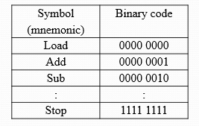
Assembly Language
Machine instruction is simply a string of binary digits. With a view to increase readability, programmers assigned appropriate symbols to the op-codes on the basis of the operation performed by the instructions. The symbols (Typical codes) of a hypothetical machine are given in Table.
An assembly language is a low-level language for programming computers. "close to the hardware." It implements a symbolic representation of the numeric machine codes and other constants needed to program a particular CPU architecture

Slide 13
Assembly Cont’’d
An example of a program code to add and store two numbers would be:
LDA A, 20 : load accumulator A with the value 20
ADD A, 10 : add the value 10 to accumulator A
STO B, A : store contents of accumulator A into
storage register B
NOP : no operation (stop here)

Slide 14
Generations of Programming Languages
The programming languages can be classified into five generations of programming languages.
First generation Languages (1GL)
Second generation Languages(2GL)
Third generation Languages (3GL)
Fourth generation Languages (4GL)
Fifth generation languages (5GL)

Slide 15
First Generation Languages (1GL)
The machine language comprising 0s and 1s is termed a 1st generation computer language. It is a machine-dependent language designed to program as per the architecture of the processor of the machine.
Example machine instruction: 11010111 10011011
Since it is a machine language, no translation is required and the program runs very fast and efficiently on the machine

Slide 16
Second Generation Languages (2GL)
Assembly languages are called 2nd generation programming languages. An assembly language is a sugared form of the machine language. It uses symbols, called mnemonics, to write the programming code. The symbolic codes are easier to comprehend as compared to the code written using binary language.
Example assembly instruction: Load Val
The assembly instructions have one-to-one correspondence with their equivalent machine instructions and therefore both machine and assembly languages are also called low-level languages.

Slide 17
Third Generation Languages (3GL)
These languages are also called high-level languages. The architecture of a 3GL is different from that of the underlying machine. As discussed earlier, 3GL (high-level languages) are further divided into procedural, object oriented, and problem oriented languages.
Examples of 3GL are: ‘C’, ‘C++’, Java, Python, etc.
Fourth Generation Languages (4GL)
Fourth generation languages (4GL) are one level above the third generation languages. 4GL have been developed keeping in view the following observation: “The number of lines of documented, delivered code produced per programmer per day is constant, regardless of the language “

Slide 18
4GL offer non-procedural constructs such as ‘sort’, ‘index’, ‘search’, ‘create table’ etc. A non-procedural construct performs a task for which the programmer need not provide the programming logic. The language has built-in logic for the construct. Thus, the programming effort is drastically reduced. For instance, a programmer can issue a statement such as that given below:
‘Search all records where Marks > 70’
It may be noted that the programmer has not supplied the procedure for searching into the file or data base. In an equivalent 3GL program, the programmer would have had to provide some lines of code for this task.
In fact, the number of statements in a 4GL program is much less compared to an equivalent 3GL program, resulting in increased programmer productivity.
Examples of 4GL are: FoxPro, SQL, MATLAB, Oracle Reports etc.

Slide 19
Fifth Generation Languages (5GL)
The fifth generation languages have been designed to develop machines that behave like humans. These machines respond to input provided in a natural language such as English. The machines are still in development stage. If developed, these machines would be capable of learning and self-organization. Therefore, the machines are also called artificially intelligent machines. Artificial Intelligence is a branch of computer science concerned with making computers behave like humans.
Examples of fifth generation computing devices are: Game playing computers, voice recognition devices, intelligent robots that autonomously accomplish a given job based on the surroundings.
Examples of 5GL are: LISP and Prolog.

Slide 20
The timeline of the development of some popular programming languages
 | Language | Remarks
1950-56 | Assembly languages | Low level languages
1957 | FORTRAN | High level language for Sc. Applications
1958 | ALGOL | Algorithmic language supporting block structures
1960 | COBOL, LISP | Business programming and List processing
1962 | Simula | Simulation programming, first OOP language
1964 | BASIC | General purpose, easy to program language
1970 | PROLOG, Hope | Logic programming language suitable for AI applications Hope was a functional programming language
1972 | ‘C’ | High level language suitable for system programming
1973 | PASCAL | Block structured language

Slide 21
The timeline of the development of some popular programming languages
 | Language | Remarks
1983 | Smalltalk, Ada | OOP languages
1984 | ML | Functional programming
1986 | C++, Eiffel | OOP languages
1990 | Haskell | Functional programming
1990-1995 | Perl, Python, JavaScript, PHP | Scripting languages
1995 | Java | OOP language suitable for Internet programming
2000 | C# | A multi-paradigm programming language
2005-2006 | Ruby on Rails | Web application framework
2010 | (Standard) PHP | Scripting language
2014 | iOS/swift | Programming language for iOS and OS X developers

Slide 22
Types of High-level Languages
Procedure-oriented Languages
A procedure-oriented language is normally a machine independent language. It is designed to help the programmer in the accurate description of the logic of how to solve the problem at hand. The logic is coded as a high-level program comprising procedures. Importance is given to the procedure that can solve a given problem with the following view in mind. “What do we have to do to solve the problem?”
The problem at hand is divided into sub-problems. Then each sub-problem is divided into sub-sub-problems and so on, till each of them can be solved separately. Each sub-problem is coded as a procedure or function.

Slide 23
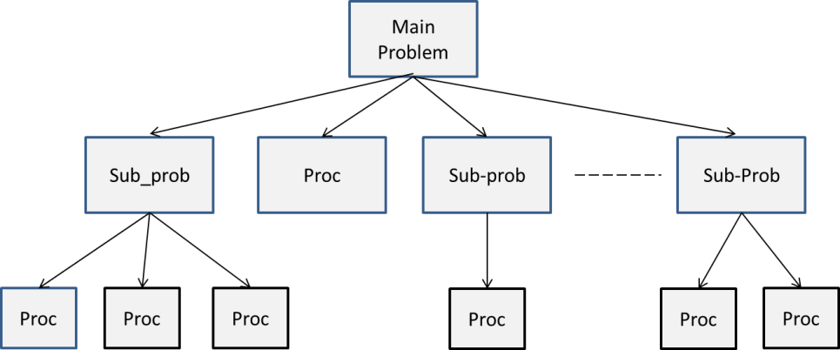
Hierarchy of Procedures
The advantage of a procedure is that if it is correct then on every call it produces correct results. Examples of procedure-oriented languages are: BASIC, FORTRAN, ‘C’, PASCAL etc. Some characteristics of procedure oriented programming are:
  Emphasis is on how to solve the problem.
  The program is divided into procedures.
  The procedures share global data.
  The code is generally not reusable.

Slide 24
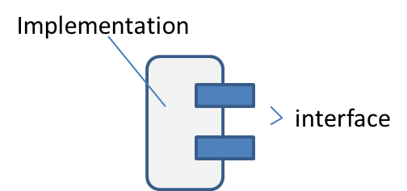
Object-oriented Programming Languages
Object-oriented programming creates programs consisting of interacting objects. An object is a software entity that mimics any real life entity, which is capable of providing services. For instance, a software agent can provide the same services through a program to a user as those provided manually by a clerk in a bank.
Software object

Slide 25
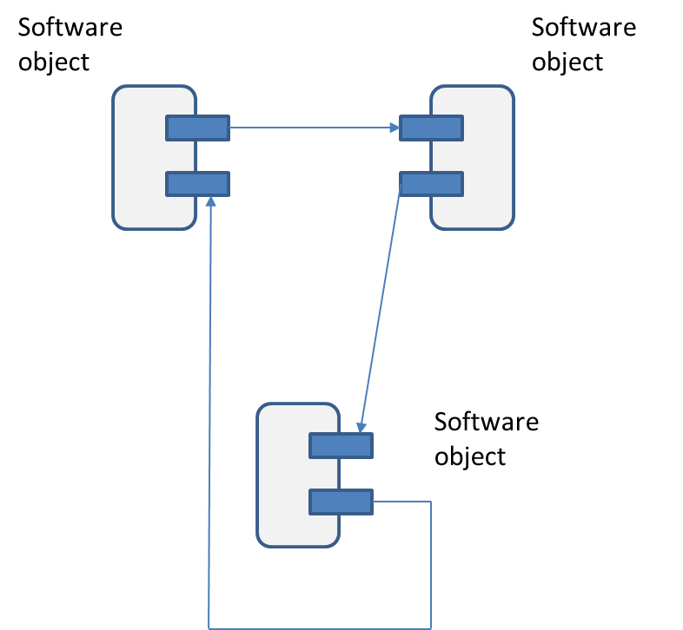
Object Oriented Programming Languages (contd.)
An object is divided into two parts: interface and implementation. In this arrangement, the data and implementation can be changed without changing the interface, resulting in reusable software objects. A programmer can very quickly assemble software by interconnecting such reusable objects, as shown in Fig. 6.8.

Slide 26
Object Oriented Programming Languages (contd.)
Object Oriented Programming has three prominent aspects: encapsulation, inheritance and polymorphism.
Some characteristics of object oriented programming are:
  More emphasis is placed on data and information.
  A program is a collection of objects.
  Objects are usable entities.
  Objects interact with each other through interfaces.
Examples of object oriented languages are: C++, java, python etc.

Slide 27
Encapsulation The meaning of Encapsulation, is to make sure that "sensitive" data is hidden from users. To achieve this, you must declare class variables/attributes as private (cannot be accessed from outside the class). If you want others to read or modify the value of a private member, you can provide public get and set methods.
inheritance In C++, it is possible to inherit attributes and methods from one class to another. We group the "inheritance concept" into two categories:
derived class (child) - the class that inherits from another class
base class (parent) - the class being inherited from
Polymorphism means "many forms", and it occurs when we have many classes that are related to each other by inheritance. Like we specified in the previous chapter; Inheritance lets us inherit attributes and methods from another class. Polymorphism uses those methods to perform different tasks. This allows us to perform a single action in different ways.

Slide 28
Problem Oriented Programming Languages
A problem-oriented language is designed to help the programmer in the accurate description of problems belonging to specific sets of problem types. This type of language is very useful in a situation where the user cannot normally, solve the problem himself or herself or the solution to the problem is too complex. The programmer does not provide the procedure for solving the problem but only describes the input-output requirements and other necessary parameters.
Examples of Problem Oriented Languages: ACSL (Advanced Continuous Simulation Language), CSMP (Continuous System Modeling Program), ECAP (Electronic Circuit Analysis Program), GPSS (General Purpose Simulation System) etc.
Some characteristics of problem-oriented programming are:
Reduction in programming effort
Flexibility of change

Slide 29
Programming Domains
There are hundreds of programming languages available to programmers. A programmer is free to choose a programming language for a specific application domain based on its specific features. A brief discussion follows, on the different programming domains.
Business applications: These languages offer features which are suitable for business application development. For instance, as the name suggests, COBOL (common business-oriented language) was very widely used for developing business applications. It has a strong support for file handling, a much needed feature by application programmers. It also supports long variable and file names resulting in an easily readable program. RPG is another language used for business application development. Nowadays this language is not in vogue.
Scientific applications: These languages support a wide variety of data types i.e., very large and very small numbers can be easily represented. However, such languages support few built in data structures. Example: ALGOL 60 and FORTRAN programming languages are very widely used to develop scientific applications. Even ‘C’ and C++ can be used for this purpose.

Slide 30
Programming Domains (contd.)
Programming languages for artificial intelligence: These languages are used to represent logical statements and their manipulation to arrive at a particular inference. LISP and PROLOG languages are widely used languages for this purpose.
Parallel Programming languages: These languages are designed to program algorithms and applications that can run on parallel computers. The program is written as a set of concurrent tasks. The tasks are mapped onto different parallel computing elements of a multiprocessing environment. These languages are also called concurrent programming languages. Concurrent Pascal, Occam, Parallel Fortran, and Hope are some parallel programming languages.

Slide 31
Popular High-level Languages
‘C’ : ‘C’ was developed by Dennis Ritchie around 1970 as a general-purpose language. He implemented the UNIX operating system in C. It is a block structured language wherein a construct is enclosed between a pair of curly braces ‘{ }’is considered a block. A block has one entry and one exit. Examples of blocks are: compound statements, loops, functions
C++’ (cee plus plus) is an object oriented programming language developed by Bjarne Stroustrup in 1980. It is a superset of the C language, and therefore shares most of the strengths and weaknesses of C.
Java is also an object oriented programming language, developed by James Gosling at Sun Microsystems. The language is designed to be platform independent, i.e., the compiled java code can run on all platforms. In fact, the Java code is compiled into a file consisting of bytecode instructions. The bytecode is a machine independent code. Each platform is loaded with a Java virtual machine (JVM) capable of interpreting bytecode instructions.

Slide 32
Python supports multiple programming paradigms: structured, object oriented, and functional programming paradigms. It has built-in data structures that help increase the productivity of the programmer. Therefore, it is highly suitable for ‘Rapid Application Development (RAD)’.

